Slide 1
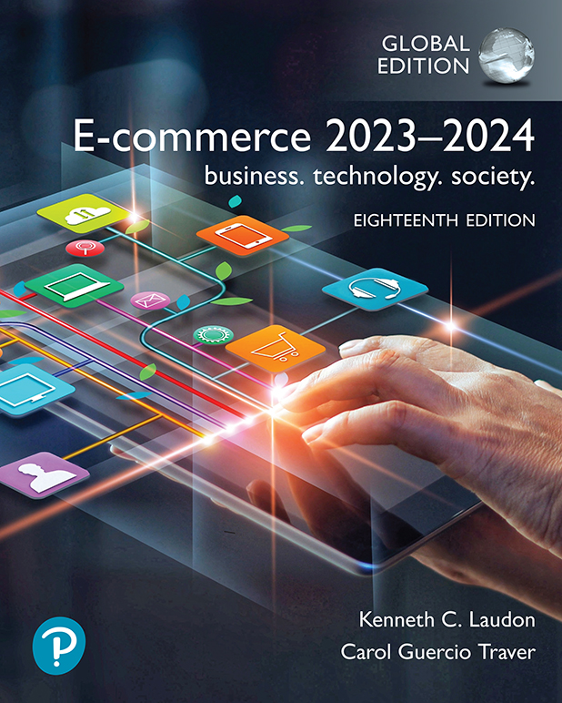

E-commerce 2023–2024: business. technology. society.
Eighteenth Edition
Chapter 3
E-commerce Infrastructure
Web
© 2023 Pearson Education Ltd. All Rights Reserved
Notes:
If this PowerPoint presentation contains mathematical equations, you may need to check that your computer has the following installed:
1) MathType Plugin
2) Math Player (free versions available)
3) NVDA Reader (free versions available)
Slides in this presentation contain hyperlinks. JAWS users should be able to get a list of links by using INSERT+F7

Slide 2
The Web
1989–1991: Web invented
Tim Berners-Lee at C E R N
H T M L, H T T P, web server, web browser
1993: Mosaic web browser w/G U I
Andreessen and others at N C S A
Runs on Windows, Macintosh, or Unix
1994: Netscape Navigator, first commercial web browser
1995: Microsoft Internet Explorer

Slide 3
Hypertext
Text formatted with embedded links
Links connect documents to one another, and to other objects such as sound, video, or animation files
Uses Hypertext Transfer Protocol (H T T P) and U R L s to locate resources on the Web
Example U R L:
http://megacorp.com/content/features/082602.html
Notes:
Note: Example URL is not an actual URL.

Slide 4
Markup Languages
Hypertext Markup Language (H T M L)
Fixed set of pre-defined markup “tags” used to format text
Controls look and feel of web pages
Used in conjunction with C S S (Cascading Style Sheets)
H T M L5 the newest version
eXtensible Markup Language (X M L)
Designed to describe data and information
Tags used are defined by user

Slide 5
Web Servers and Web Clients
Web server software
Enables a computer to deliver HTML web pages to clients on a network that request this service by sending an H T T P request
Basic capabilities: HTTP, security services (TLS), file transfer, search engine, data capture, e-mail, site management tools
Web server
May refer to either web server software or physical server
Specialized server software: Database server, ad server, mail server, media server
Web client
Any computing device attached to the Internet capable of making H T T P requests and displaying H T M L pages

Slide 6
Web Browsers
Primary purpose is to display web page, but may include added features
Google’s Chrome: about 60% of desktop market; about 40% of mobile market
Open source
Apple’s Safari: about 18% share of desktop market; 55% share of mobile market
Microsoft Edge: about 12% share of desktop market (has replaced Internet Explorer)
Mozilla Firefox: about 7% desktop
Open source

Slide 7
The Internet and Web: Features and Services
Features and services on which the foundations of e-commerce are built:
Communication tools
Search engines
Downloadable and streaming media
Web 2.0 applications and services
Web3
Virtual reality, augmented reality, and the metaverse
Intelligent digital assistants

Slide 8
Communication Tools
E-mail
Most used application of the Internet
Messaging Applications
Instant messaging
Online message boards
Internet telephony
V O I P
Videoconferencing, video chatting, telepresence

Slide 9
Insight on Business: Zoom Continues to Zoom
Class Discussion
What has your experience using Zoom and other videoconferencing services been like?
What challenges does Zoom face?
How has Zoom responded to those challenges?

Slide 10
Search Engines
Identify web pages that match queries and then provide a list of best matches (search results)
Top two providers: Google and Microsoft’s Bing
Google dominates mobile search
Use web crawlers and algorithms
Also serve as:
Shopping tools
Advertising vehicles (search engine marketing)
Tool within e-commerce sites

Slide 11
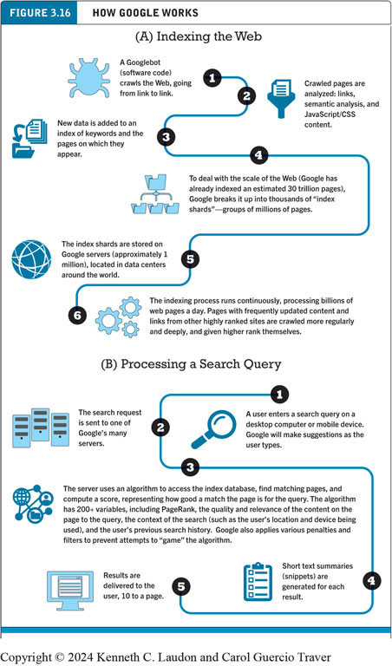
Figure 3.16 How Google Works
Notes:
Figure 3.16 page 157.
Alt Text
Long description: The flowchart is as follows: A, Indexing the web. Step 1, a Googlebot, which is a form of software code, crawls the web, going from link to link. Step 2, crawled pages are analyzed: links semantic analysis and JavaScript or C S S content. Step 3, new data is added to an index of keywords and the pages on which they appear. Step 4, to deal with the scale of the Web, Google has already indexed an estimated 30 trillion pages, Google breaks it up into thousands of index shards, groups of millions of pages. Step 5, the index shards are stored on Google servers, approximately 1 million, located in data centers around the world. Step 6, the indexing process runs continuously, processing billions of web pages a day. Pages with frequently updated content and links from other highly ranked sites are crawled more regularly and deeply and given higher rank themselves. B, Processing a Search Query. Step 1, a user enters a search query on a desktop computer or mobile device. Google will make suggestions as the user types. Step 2, the search request is sent to one of Google’s many servers. Step 3, the server uses an algorithm to access the index database, find matching pages, and compute a score, representing how good a match the page is for the query. The algorithm has 200 plus variables, including page rank, the quality and relevance of the content on the page to the query, the context of the search such as the user’s location and device being used, and the user’s previous search history. Google also applies various penalties and filters to prevent attempts to game the algorithm. Step 4, short text summaries or snippets are generated for each result. Step 5, results are delivered to the user, 10 to a page.

Slide 12
Downloadable and Streaming Media
Downloads:
Growth in broadband connections enables large media file downloads
Streaming technologies
Enables music, video, and other large files to be sent to users in chunks so that the file can play uninterrupted
Podcasting
Explosion in online video viewing

Slide 13
Web 2.0 Features and Services
Online social networks
Services that support communication among networks of friends, acquaintances, people with similar interests
Blogs
Personal web page of chronological entries
Enables web page publishing with no knowledge of H T M L
Wikis
Enables documents to be written collectively and collaboratively
E.g., Wikipedia

Slide 14
Web3
Still at a conceptual stages; does not yet exist
New kind of Internet service conceived as being built using blockchain
Proponents envision it as being much more decentralized than the current Web environment; controlled by creators and users rather than Big Tech companies
Critics
Doubt that blockchain technology can handle the amount of data that is processed on Web
Argue that centralized services would be required, defeating the central purpose of Web3

Slide 15
Virtual Reality, Augmented Reality, and the Metaverse (1 of 2)
Virtual reality (V R)
Immersing users within virtual world
Typically uses head-mounted display (H M D)
Oculus Rift, Vive, PlayStation V R
Augmented reality (A R)
Overlaying virtual objects over the real world, via mobile devices or H M D s
Pokémon G O
Mixed reality (A R)
Enhanced version of A R

Slide 16
Virtual Reality, Augmented Reality, and the Metaverse (2 of 2)
Metaverse
Immersive, visual 3-D virtual reality in which users can connect, socialize, and collaborate
Facebook has rebranded as Meta
Tremendous hype
Currently being used for gaming and advertising
Many companies are working on metaverse-related projects

Slide 17
Intelligent Digital Assistants
Computer search engine using:
Natural language
Conversational interface, verbal commands
Situational awareness
Can handle requests for appointments, flights, routes, event scheduling, and more.
Examples:
Apple’s Siri
Google Now/Google Assistant
Amazon Alexa

Slide 18
Mobile Apps
Use of mobile apps has exploded
Most popular entertainment media, over T V
Always present shopping tool
Almost all top 100 brands have an app
Platforms
iPhone/iPad (i O S), Android
App marketplaces
Google Play, Apple’s App Store, Amazon’s Appstore

Slide 19
Careers in E-commerce
Position: E-commerce Specialist
Qualification/Skills
Preparing for the Interview
Possible Interview Questions

Slide 20

Copyright
This work is protected by United Kingdom copyright laws and is provided solely for the use of instructors in teaching their courses and assessing student learning. Dissemination or sale of any part of this work (including on the World Wide Web) will destroy the integrity of the work and is not permitted. The work and materials from it should never be made available to students except by instructors using the accompanying text in their classes. All recipients of this work are expected to abide by these restrictions and to honor the intended pedagogical purposes and the needs of other instructors who rely on these materials.

